Slide 1


Welcome to Deep Learning programming!
TensorFlow and Keras for Deep Learning Research

Slide 2
Feedback is greatly appreciated!

Slide 3

Objective
What is Deep learning
Application of Deep learning
A brief introduction to how Deep Learning works
Introduction to Keras library
Basic operations in Keras
Use case: diabetes prediction

Slide 4
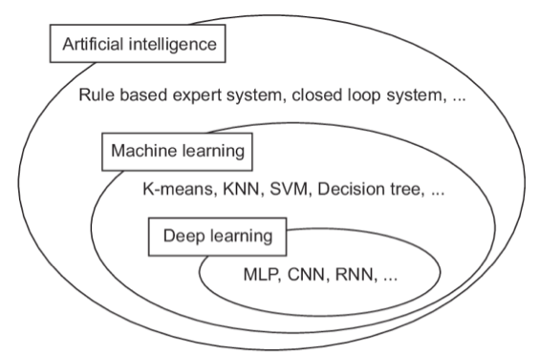
Venn diagram

Slide 5
What is Deep Learning?
Deep Learning is the "set of algorithms in machine learning that attempt to learn in multiple levels, corresponding to different levels of abstraction" (much-debated definition).
Deep learning, is an approach to AI. Specifically, it is a type of machine learning, a technique that allows computer systems to improve with experience and data:
Machine learning is the only viable approach to building AI systems that can operate in complicated, real-world environments.
Deep learning is a particular kind of machine learning that achieves great power and flexibility by learning to represent the world as a nested hierarchy of concepts, with each concept defined in relation to simpler concepts, and more abstract representations computed in terms of less abstract ones.

Slide 6
What can Deep Learning do?

Slide 7
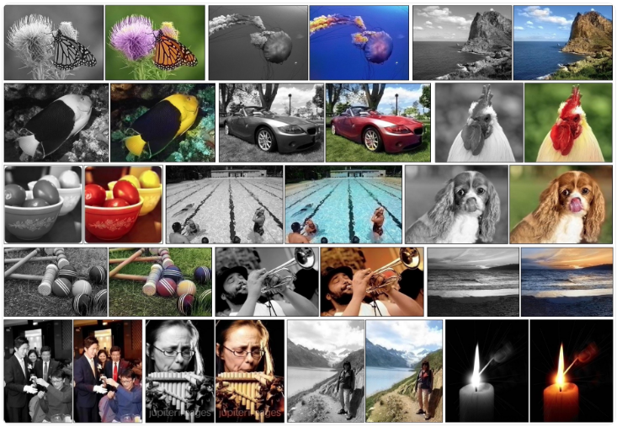
What can Deep Learning do?
Colorization of Black and White Photographs
https://machinelearningmastery.com/inspirational-applications-deep-learning/

Slide 8
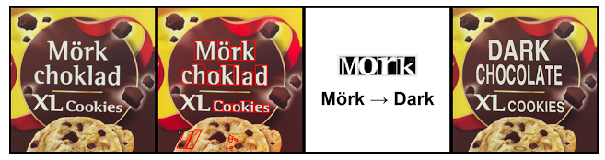

What can Deep Learning do?
Instant Visual Translation
https://machinelearningmastery.com/inspirational-applications-deep-learning/

Slide 9

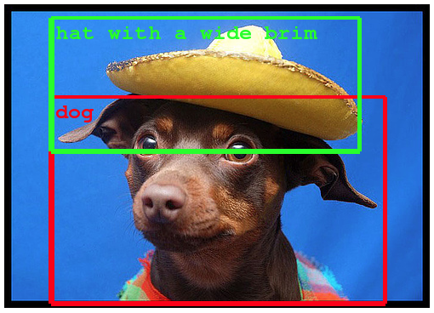
What can Deep Learning do?
Example of Object Classification
https://machinelearningmastery.com/inspirational-applications-deep-learning/

Slide 10
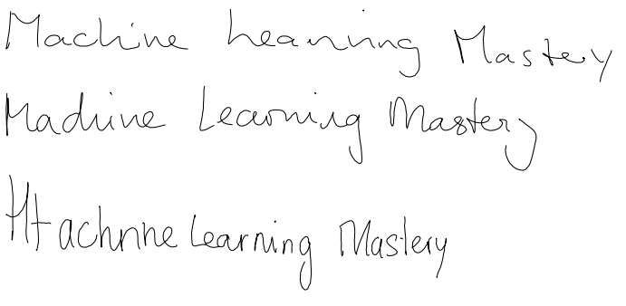
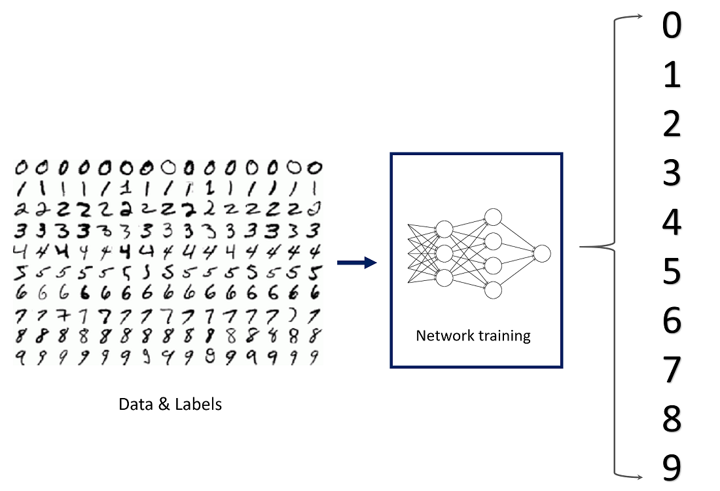
What can Deep Learning do?
Sample of Automatic Handwriting Generation
Handwritten Digits Classification
https://machinelearningmastery.com/inspirational-applications-deep-learning/

Slide 11
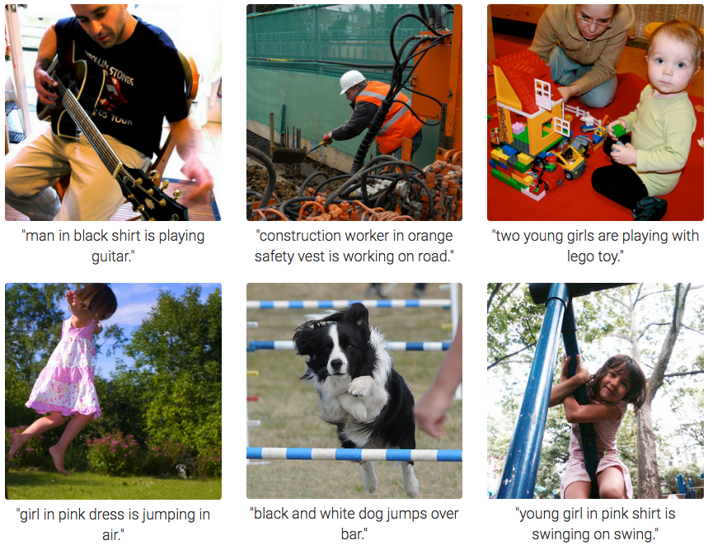
What can Deep Learning do?
Automatic Image Caption Generation
https://machinelearningmastery.com/inspirational-applications-deep-learning/

Slide 12
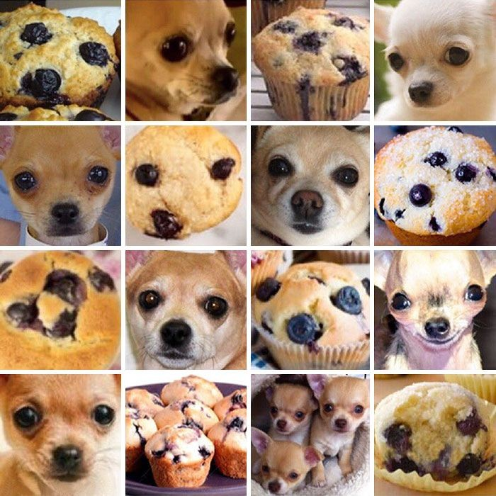
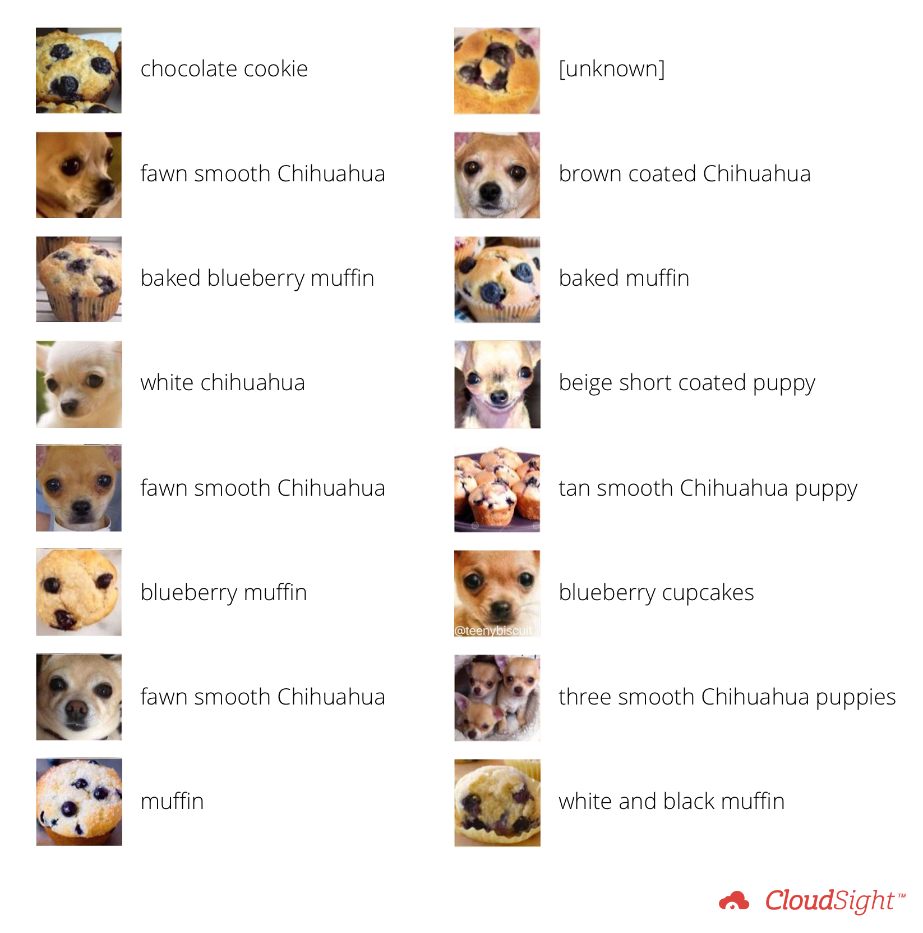
What can Deep Learning do?
https://blog.cloudsight.ai/chihuahua-or-muffin-1bdf02ec1680

Slide 13
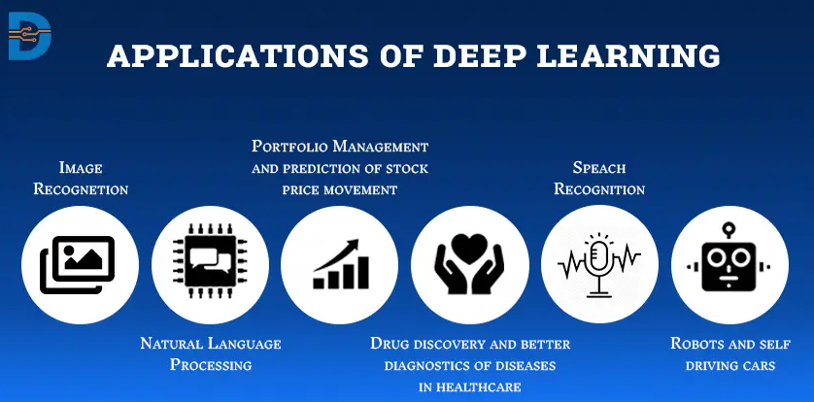

What can Deep Learning do?

Slide 14
Comparison of Machine learning & Deep learning

Slide 15
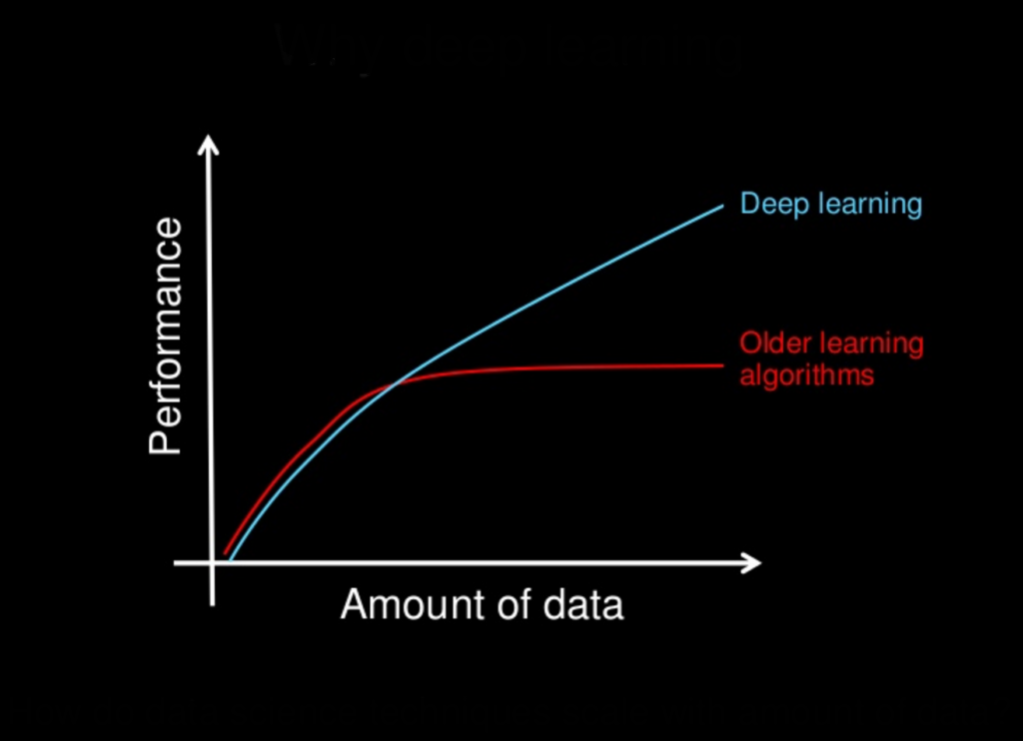
1. Data Dependency
https://machinelearningmastery.com/what-is-deep-learning/

Slide 16
2. Feature Engineering
Feature engineering is a process of putting domain knowledge into the creation of feature extractors to reduce the complexity of the data and make patterns more visible to learning algorithms to work
In Machine learning, most of the applied features need to be identified by an expert and then hand-coded as per the domain and data type
Deep learning algorithms try to learn high-level features from data. This is a very distinctive part of Deep Learning and a major step ahead of traditional Machine Learning

Slide 17

hierarchical feature extraction of Deep Learning
How can you realize and differentiate circle and square?

Slide 18
Hierarchical feature extraction of Deep Learning
The first thing our eyes do is
1. Check whether there are 4 lines associated with a figure or not
2. If we find 4 lines, we further check, if they are
a. connected
b. closed
c. perpendicular
d. they are equal as well

Slide 19
hierarchical feature extraction of Deep Learning
So, we took a complex task (identifying a square) and broke it in simple less abstract tasks
Deep Learning essentially does this at a large scale

Slide 20
3. Execution time
Usually, a deep learning algorithm takes longer time to train. This is because there are so many parameters in a deep learning algorithm that training them takes longer than usual.

Slide 21
How does Deep Learning work?

Slide 22
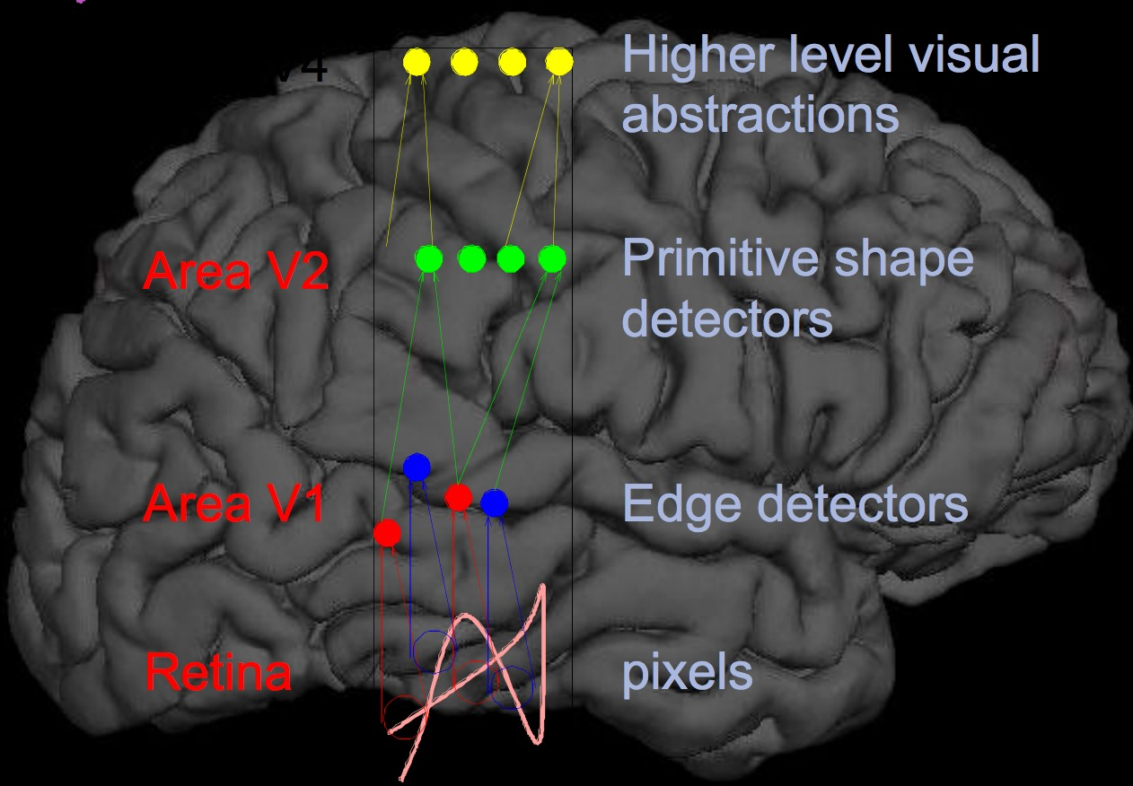
"Brain" -like: Feature Hierarchies
A deep learning model is designed to continually analyze data with a logic structure similar to how a human would draw conclusions

Slide 23
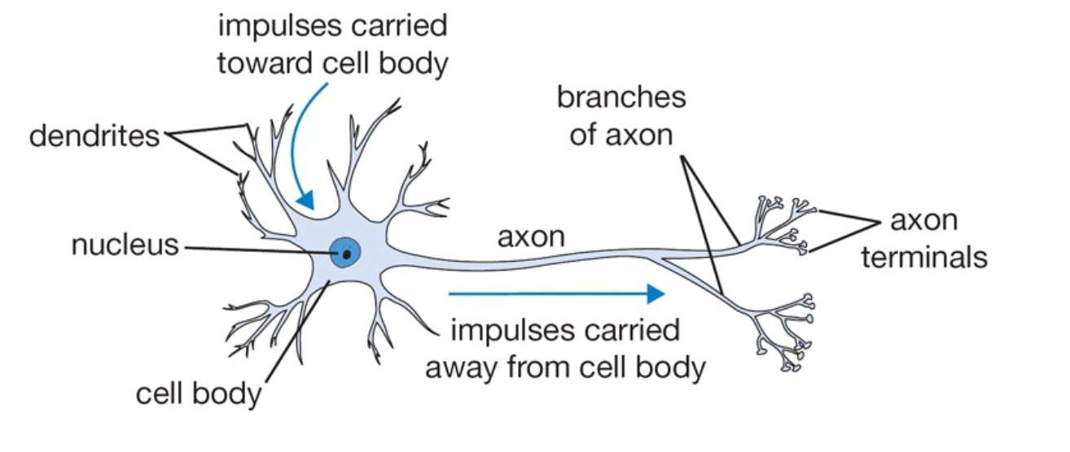
Biological Neuron

Slide 24
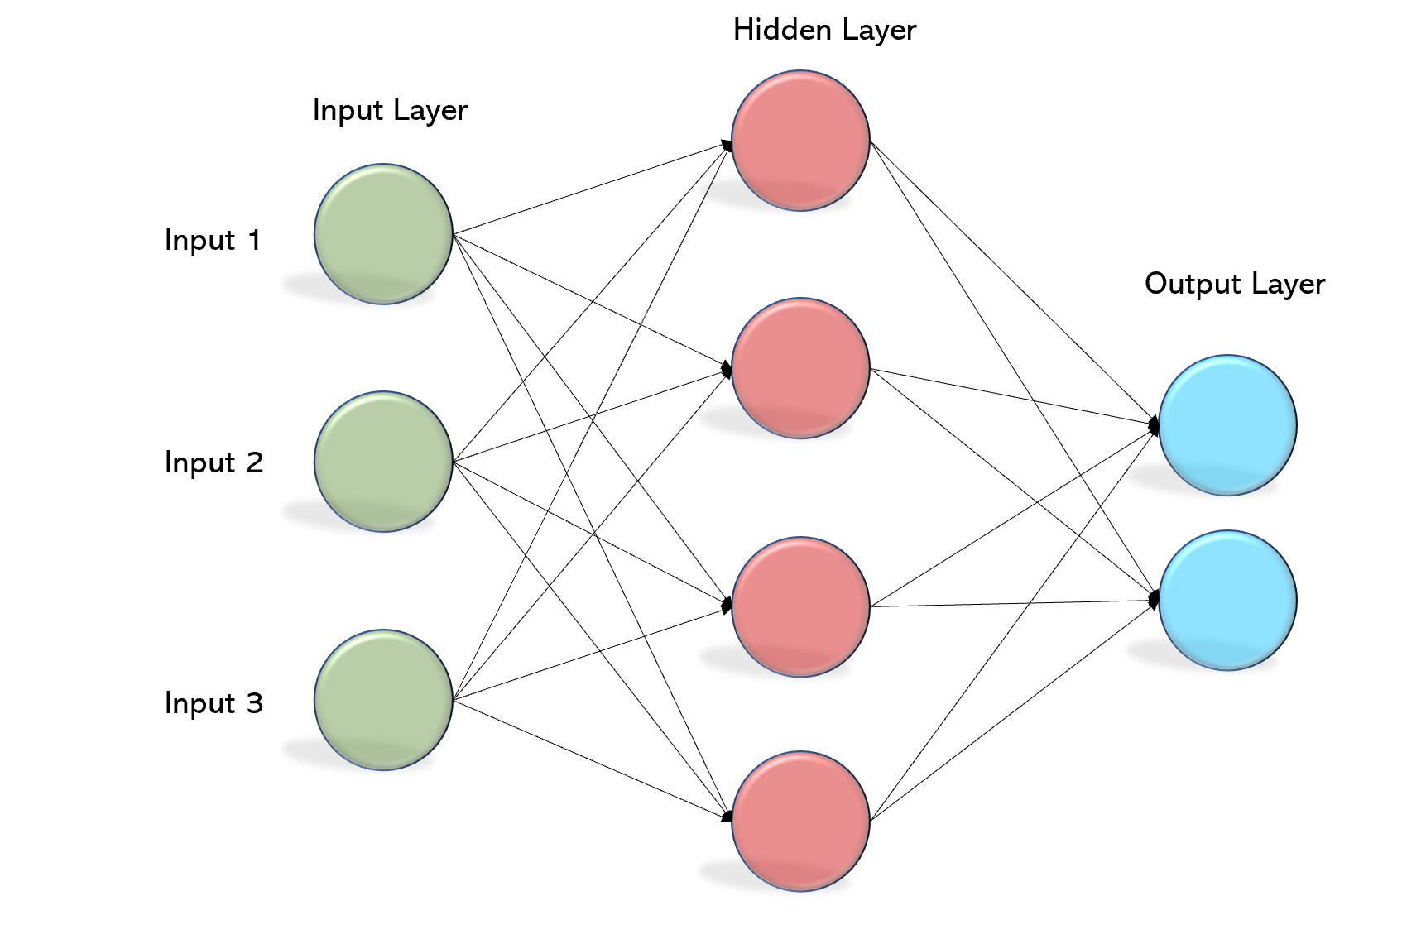
1. Multi-Layer Perceptron (MLP)
is a class of feedforward artificial neural network
An MLP consists of at least three layers of nodes: an input layer, a hidden layer and an output layer. Except for the input nodes, each node is a neuron that uses a nonlinear activation function.
https://machinelearningmastery.com/neural-networks-crash-course/ https://becominghuman.ai/multi-layer-perceptron-mlp-models-on-real-world-banking-data-f6dd3d7e998f

Slide 25
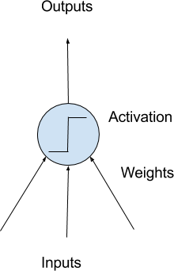
2. Neurons
The building block for neural networks are artificial neurons.
These are simple computational units that have weighted input signals and produce an output signal using an activation function
https://machinelearningmastery.com/neural-networks-crash-course/

Slide 26
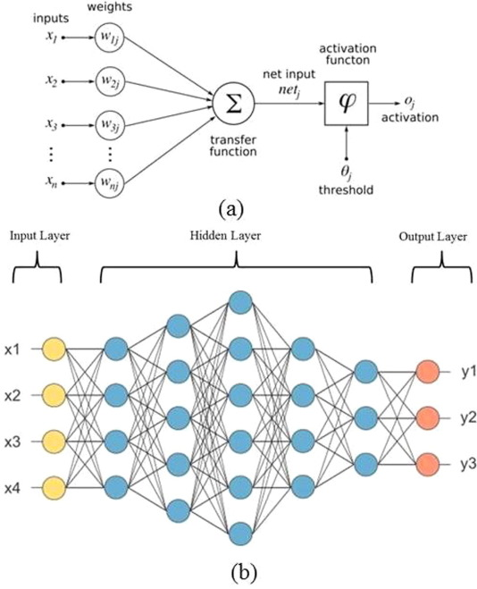
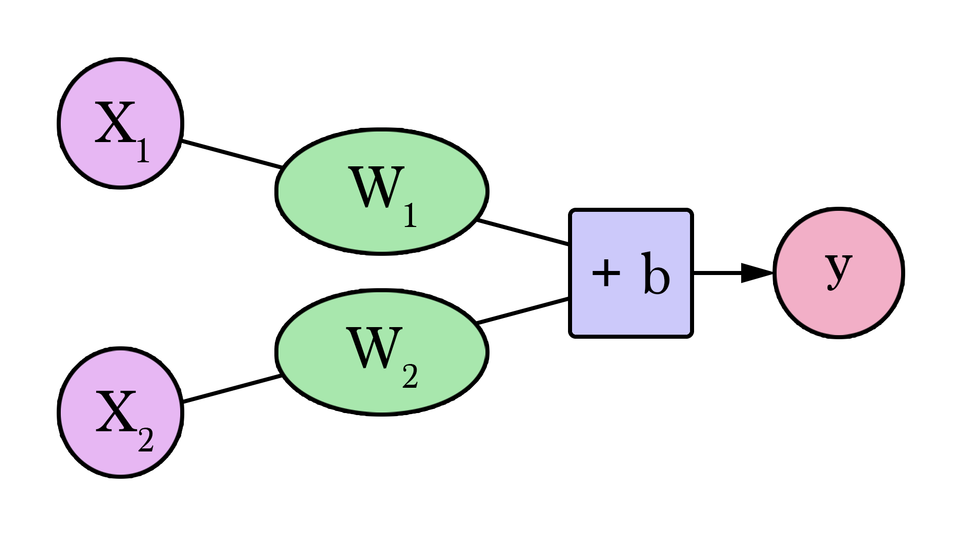
Artificial Neurons
Input
Weight
bias
Output
http://jalammar.github.io/visual-interactive-guide-basics-neural-networks/

Slide 27
Neuron Weights
You may be familiar with linear regression, in which case the weights on the inputs are very much like the coefficients used in a regression equation.
Weights are often initialized to small random values, such as values in the range 0 to 0.3
Each neuron also has a bias which can be thought of as an input that always has the value 1.0 and it too must be weighted.
https://machinelearningmastery.com/neural-networks-crash-course/

Slide 28
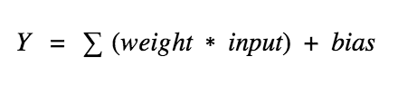
Activation
The weighted inputs are summed and passed through an activation function, sometimes called a transfer function.
Simply put, it calculates a “weighted sum” of its input, adds a bias and then decides whether it should be “fired” or not.
Step, Linear, Non-Linear, Sigmoid, Softmax, Tanh, and ReLu activation functions.
https://machinelearningmastery.com/neural-networks-crash-course/
https://medium.com/the-theory-of-everything/understanding-activation-functions-in-neural-networks-9491262884e0

Slide 29
3. Networks of Neurons
Neurons are arranged into networks of neurons
A row of neurons is called a layer and one network can have multiple layers.

Slide 30

Neural Network Architecture

Slide 31
Neural Network Architecture
A Visual And Interactive Look at Basic Neural Network Math
http://jalammar.github.io/feedforward-neural-networks-visual-interactive/

Slide 32
4. Training Networks
Once configured, the neural network needs to be trained on your dataset.

Slide 33
Neural Network Architecture
Input Nodes (input layer): No computation is done here within this layer, they just pass the information to the next layer
Hidden nodes (hidden layer): In Hidden layers is where intermediate processing or computation is done, they perform computations and then transfer the weights (signals or information) from the input layer to the following layer
Output Nodes (output layer): Here we finally use an activation function that maps to the desired output format
Connections and weights: The network consists of connections, each connection transferring the output of a neuron to the input of another neuron

Slide 34
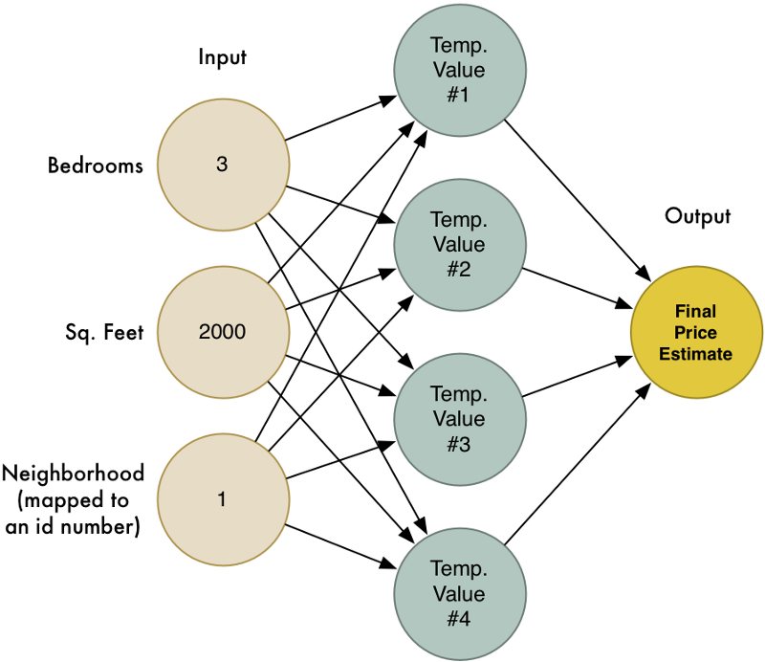
House price prediction neural network

Slide 35
Deep Learning Libraries and Platforms

Slide 36
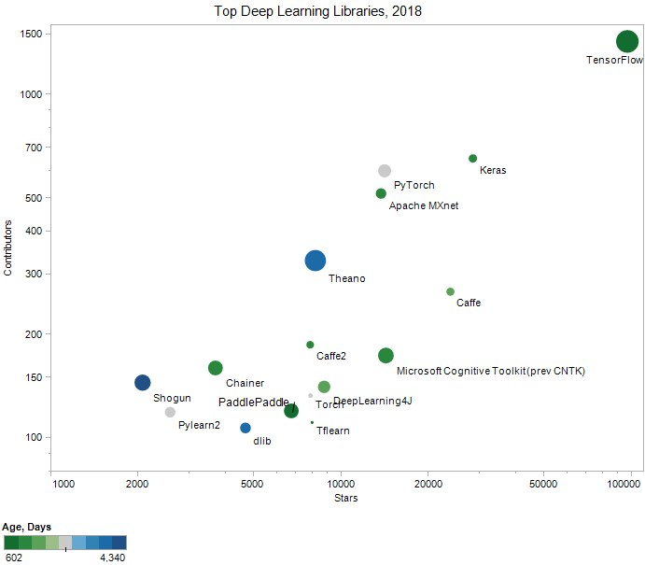
Deep Learning Libraries
TensorFlow
Keras
Caffe
Microsoft Cognitive Toolkit
PyTorch
Apache MXnet
DeepLearning4J
Theano
TFLearn
Torch
Caffe2
PaddlePaddle
DLib
Chainer
Neon
Lasagne
https://www.kdnuggets.com/2018/04/top-16-open-source-deep-learning-libraries.html

Slide 37
Keras is multi-backend, multi-platform
Develop in Python, R
On Unix, Windows, OSX
Run the same code with…
TensorFlow
CNTK
Theano
MXNet
PlaidML
- ??
CPU, NVIDIA GPU, AMD GPU, TPU...

Slide 38
What's TensorFlow™?
Open source software library for numerical computation using data flow graphs?!
Originally developed by Google Brain Team to conduct machine learning and deep neural networks research
General enough to be applicable in a wide variety of other domains
TensorFlow provides an extensive suite of functions and classes that allow users to build various models from scratch
https://www.tensorflow.org/
https://www.easy-tensorflow.com/tf-tutorials/basics/graph-and-session

Slide 39
What’s Keras
Keras is a high-level library
Models created by Keras can be executed on a backend
Tensorflow (default)
Theano
CNTK (Beta)
It runs smoothly on both CPU and GPU
Keras supports almost all the models of a neural network – fully connected, convolutional, pooling, recurrent, embedding, etc.
Keras, being modular in nature
facilitate experimentations

Slide 40
Getting started with programming

Slide 41
How to use Keras: An Introduction
Three API styles:
Sequential Model
Dead simple
Only for single-input, single-output, sequential layer stack
(does not allow cases where you need to create models that shares layers)
Good for 70% of the use cases
Functional API
Like playing with lego bricks
A lot more flexibility
Multi input, Multi output, arbitrary graph topologies
Like residual networks
Model subclassing
Maximum flexibility
https://keras.io/models/about-keras-models/

Slide 42
House price prediction neural network

Slide 43
Sequential Model
The sequential model is a linear stack of layers
Create a sequential model by passing a list of layer instances to the constructor
layers are added piecewise via the sequential object
input arrays of shape (*, 3)
output arrays of shape (*, 4)
from keras.models import Sequential from keras.layers import Dense model = Sequential() model.add(Dense(4, input_dim=3)) model.add(Dense(1))

Slide 44
Specifying the input shape
The model needs to know what input shape it should expect
the first layer in a Sequential Model needs to receive information about its input shape
There are several possible ways to do this:

Slide 45
Ways of specifying input_shape
Pass an input_shape argument to the first layer.
This is a shape tuple(a tuple of integers or None entries)
Some 2D layers, such as Dense, support the specification of their input shape via the argument input_dim
model = Sequential() model.add(Dense(32, input_shape=(784,)))
model = Sequential() model.add(Dense(32, input_dim=784))

Slide 46
Functional model
you must create and define a standalone "Input" layer that specifies the shape of input data
"shape" argument is a tuple that indicates the dimensionality of the input data
The layers in the model are connected pairwise
This is done by specifying where the input comes from when defining each new layer
Note how the " input_layer " layer connects to the "Dense" layer
Create the model: As with the Sequential API, the model is the thing that you can summarize, fit, evaluate, make predictions
from keras.models import Model from keras.layers import Input from keras.layers import Dense
input_layer = Input(shape=(3,)) hidden_layer = Dense(4)(input_layer)
out_layer = Dense(1)(input_layer) model = Model(inputs= input_layer, outputs=out_layer)

Slide 47
Common attribute of sequential and functional model
Model.layer: flattened list of the layers comprising the model
Model.input: the list of input tensors of the model.
Model.output: the list of output tensors of the model.
Model.summary(): prints a summary representation of your model
Model.get_config(): returns a dictionary containing the configuration of the model
Model.get_weights(): returns a list of all weight tensors in the model, as Numpy arrays
Model.set_weights(): sets the values of the weights of the model from a list of Numpy arrays
https://keras.io/models/about-keras-models/

Slide 48
Compilation
Before training a model, we need to configure the learning process via the Compilation method
It receives three arguments:
An optimizer
A loss function
A list of metrics
model.compile(optimizer='rmsprop', loss='binary_crossentropy', metrics=['accuracy'])

Slide 49
Training
Trained on Numpy arrays of input data and labels
Data: Numpy array of training data
Labels: Numpy array of target (label) data
For training a model, you will typically use the Fit() function
import numpy as np data = np.random.random((1000, 100)) labels = np.random.randint(2, size=(1000, 1)) # Train the model, iterating on the data in batches of 32 samples model.fit(data, labels, epochs=10, batch_size=32)

Slide 50

Use case: predict Diabetes

Slide 51
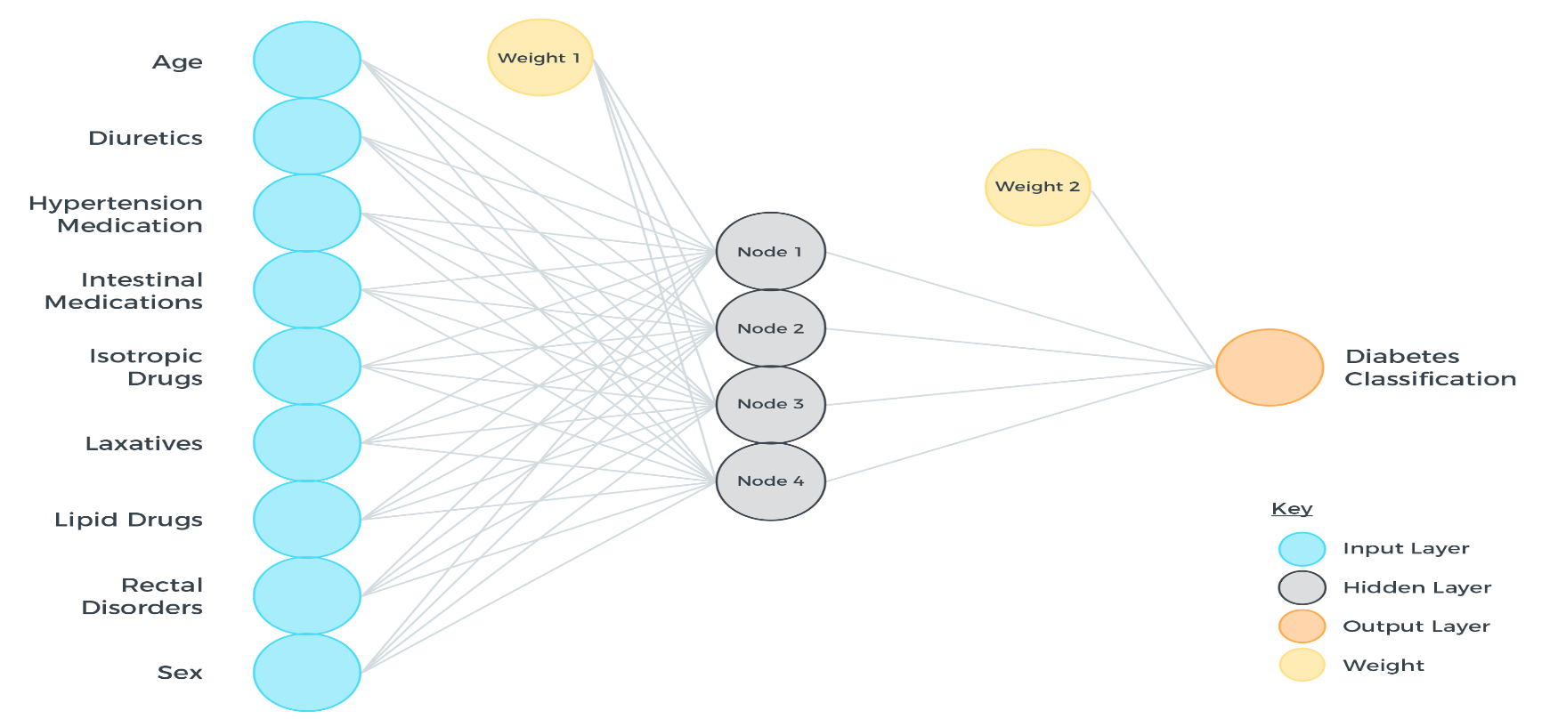
Diabetes Neural Network

Slide 52
Use case: predict diabetes
dataset = pd.read_csv("diabetes.csv", header=None).values # print(dataset) import numpy as np X_train, X_test, Y_train, Y_test = train_test_split(dataset[:,0:8], dataset[:,8], test_size=0.25, random_state=87) my_first_nn = Sequential() # create model my_first_nn.add(Dense(20, input_dim=8, activation='relu')) # hidden layer my_first_nn.add(Dense(1, activation='sigmoid')) # output layer
my_first_nn.compile(loss='binary_crossentropy', optimizer='adam') my_first_nn_fitted = my_first_nn.fit(X_train, Y_train, epochs=100, verbose=0, initial_epoch=0) print(my_first_nn.summary()) print(my_first_nn.evaluate(X_test, Y_test, verbose=0))
Why sigmoid ?!

Slide 53
Result
Layer (type) Output Shape Param #
=================================================================
dense_1 (Dense) (None, 20) 180
_________________________________________________________________
dense_2 (Dense) (None, 1) 21
=================================================================
Total params: 201
Trainable params: 201
Non-trainable params: 0

Slide 54
References
https://www.youtube.com/watch?v=yX8KuPZCAMo
https://www.linkedin.com/pulse/list-useful-links-videos-slides-articles-deep-farshid-pirahansiah?articleId=6274891035365732352#comments-6274891035365732352&trk=prof-post

Slide 55
Books
TensorFlow for Machine Intelligence (TFFMI)
Hands-On Machine Learning with Scikit-Learn and TensorFlow. Chapter 9: Up and running with TensorFlow
Fundamentals of Deep Learning. Chapter 3: Implementing Neural Networks in TensorFlow (FODL)
Deep Learning with Keras: Implementing deep learning models and neural
20

